Slide 1


EcoChampionHub: Bridging the Gap to a Sustainable Future
Welcome to EcoChampionHub. We connect individuals and communities to a sustainable future. Discover the solutions we provide and the impact we're making. Join us in creating a better planet for all.
by Mohammed Arsh

Slide 2















Sustainable Development Goals in India
No Poverty
Zero Hunger
Good Health and Well-being
Quality Education
End poverty in all its forms everywhere
End hunger, achieve food security and improved nutrition
Ensure healthy lives and promote well-being for all
Ensure inclusive and equitable quality education
Gender Equality
Clean Water and Sanitation
Affordable and Clean Energy
Decent Work and Economic Growth
Achieve gender equality and empower all women and girls
Ensure availability and sustainable management of water
Ensure access to affordable, reliable, sustainable and modern energy
Promote sustained, inclusive and sustainable economic growth
Industry, Innovation and Infrastructure
Reduced Inequalities
Sustainable Cities and Communities
Responsible Consumption and Production
Build resilient infrastructure, promote inclusive and sustainable industrialization
Reduce inequality within and among countries
Make cities and human settlements inclusive, safe, resilient and sustainable
Ensure sustainable consumption and production patterns
Climate Action
Life Below Water
Life on Land
Peace, Justice and Strong Institutions
Take urgent action to combat climate change and its impacts
Conserve and sustainably use the oceans, seas and marine resources
Protect, restore and promote sustainable use of terrestrial ecosystems
Promote peaceful and inclusive societies for sustainable development
Partnerships for the Goals
Strengthen the means of implementation and revitalize the Global Partnership

Slide 3
The Sustainability Paradox: Why Isn't Everyone On Board?
Lack of Awareness
Education and Outreach
Inconvenience and Cost
Incentives and Support
Many people are unaware of the severity and impact of environmental issues.
Increase public awareness through educational programs, campaigns, and community events.
Sustainable practices are often perceived as inconvenient or more expensive.
Provide incentives, subsidies, and resources to make sustainable choices easier and more affordable.

Slide 4





EcoChampionHub: Your All-In-One Platform for Sustainable Living
Curated Eco-Products
Eco-Challenges
Community
Educational Resources
Shop from sustainable brands. Support ethical and environmentally friendly companies.
Take on daily challenges. Track your impact and earn rewards. Get help on your eco journey.
Connect with other EcoChampions. Share tips and inspire action.
Access articles, guides, and courses. Expand your knowledge and skills in sustainability.

Slide 5
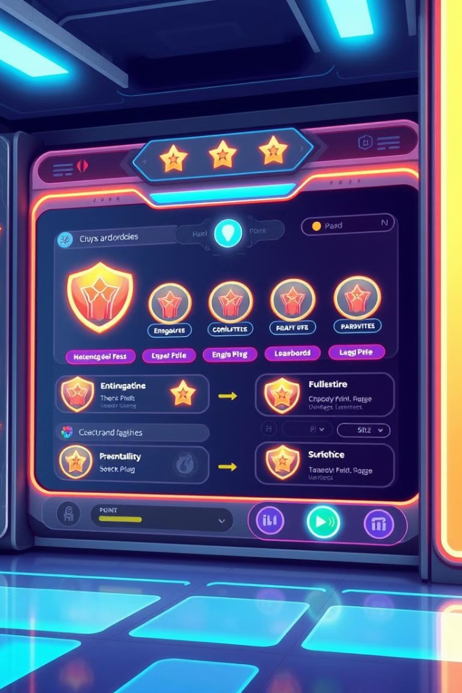



Gamified Engagement: Turning Eco-Actions into Rewarding Experiences
Track Your Progress
Monitor your daily eco-actions. See the impact of your choices.
Earn Rewards
Get points for completing challenges. Redeem them for discounts. You can save money.
Compete with Friends
Join leaderboards and friendly competitions. Inspire each other.

Slide 6

Student Power: Igniting the Next Generation of Eco-Champions
1
Campus Challenges
2
Educational Resources
3
Career Opportunities
Engage students with campus-specific challenges. It will inspire them to help.
Access educational materials. Learn about sustainability.
Connect with sustainable companies. Find internships and jobs.

Slide 7
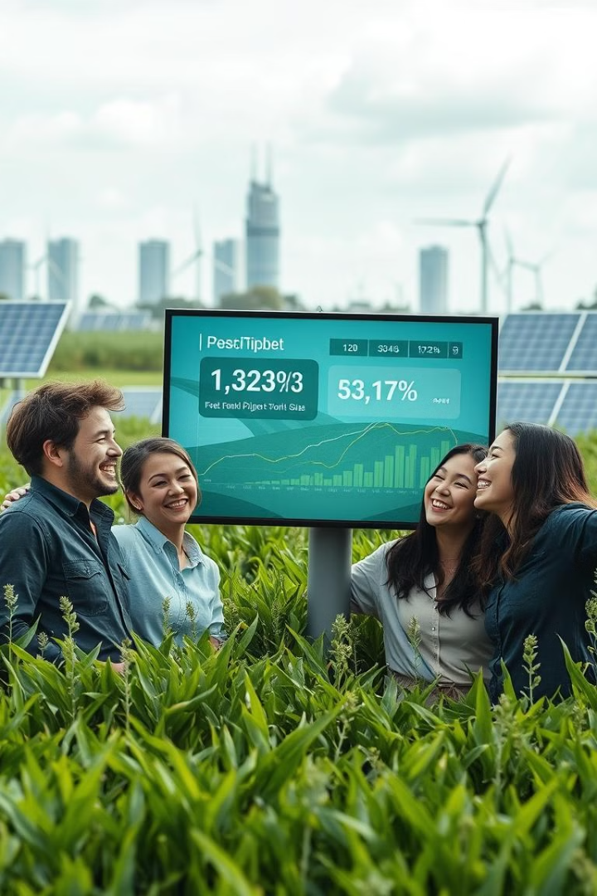
EcoChampionHub Impact: Real Results, Measurable Change
20K
50T
Users
CO2 Saved
Growing community.
Reduced carbon footprint.
100+
Partners
Supporting sustainable companies.

Slide 8




Connecting to the SDGs: How We're Contributing to Global Goals
Partnerships for the Goals
1
Collaborating for solutions.
Quality Education
2
Raising awareness.
Responsible Consumption
3
Promoting sustainable products.
Climate Action
4
Reducing carbon emissions.

Slide 9
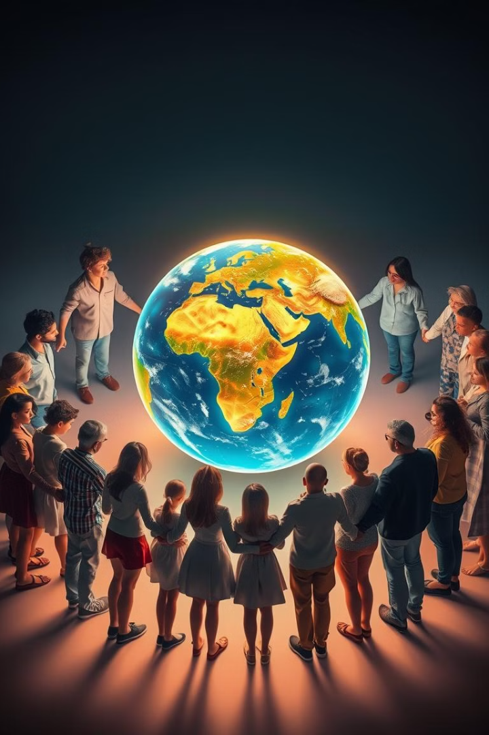
Join the Movement: Become an EcoChampion Today
1
Visit EcoChampionHub
Explore our platform and discover a world of sustainable solutions.
2
Take Action
Start making a difference with every eco-conscious choice you make.
3
Connect with Community
Join a network of like-minded EcoChampions and share your passion.
4
Create a Sustainable Future
Together, we can build a better planet for generations to come.

